Slide 1
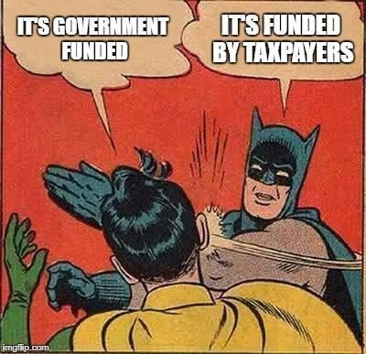
It’s all important but…
The non-negotiables
Health & safety
Child protection and protection of vulnerable adults
Safe to Create
Financial controls

Slide 2
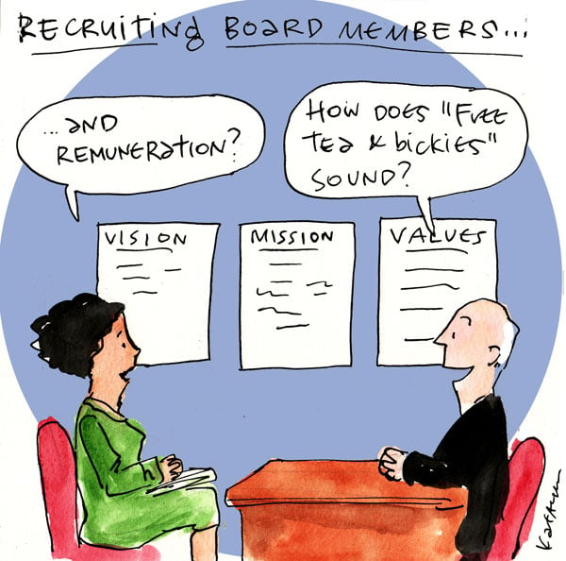
Building your board
Shared values & vision for the organisation
People who want to see you and the organisation succeed
People who push you forward and ask also challenging questions
Many different voices
Competences are important but trust is everything

Slide 3
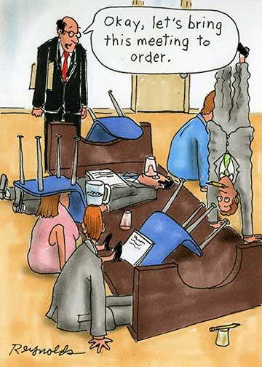
Working with your board
Reporting to a board: not just a list of successes, highlight risks and opportunities
Strategy ↔ operational goals ↔ your reports
Build a loop for feedback and learning
Keep it simple & effective
Ask for help, make space for people to help
CEO & Chair relationship
Ultimately, your board is your boss

Slide 4

Policy requirements
Different requirements for different size and types of organisations
Policies are your friend – they help to ensure that information is shared, and risks are managed
Policy development is an ongoing journey
Join membership organisations (ISACS, The Wheel, Youth Theatre Ireland, local volunteer network…)
Learn from others but don’t copy & paste. Policies mean nothing if they are not followed
Keep it simple!

Slide 5
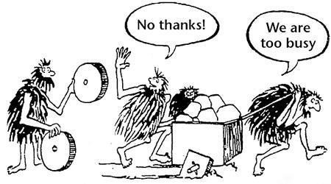
People & art at the core
Busyness-bubble
Pause and make time for reflection when you can – build it into your calendar and culture
Keep it “circusy”
Make sure that you keep your values & impact at the front
Find ways to connect and motivate people through your art - board members also want to feel connected to the work

Slide 6
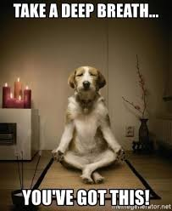
So easy to get overwhelmed
Make sure you have a simple action plan with a realistic timeline – not everything can nor needs to get done right now
Recognise your progress and find moments to celebrate
And always ask for help!
THANK YOU

