Slide 1
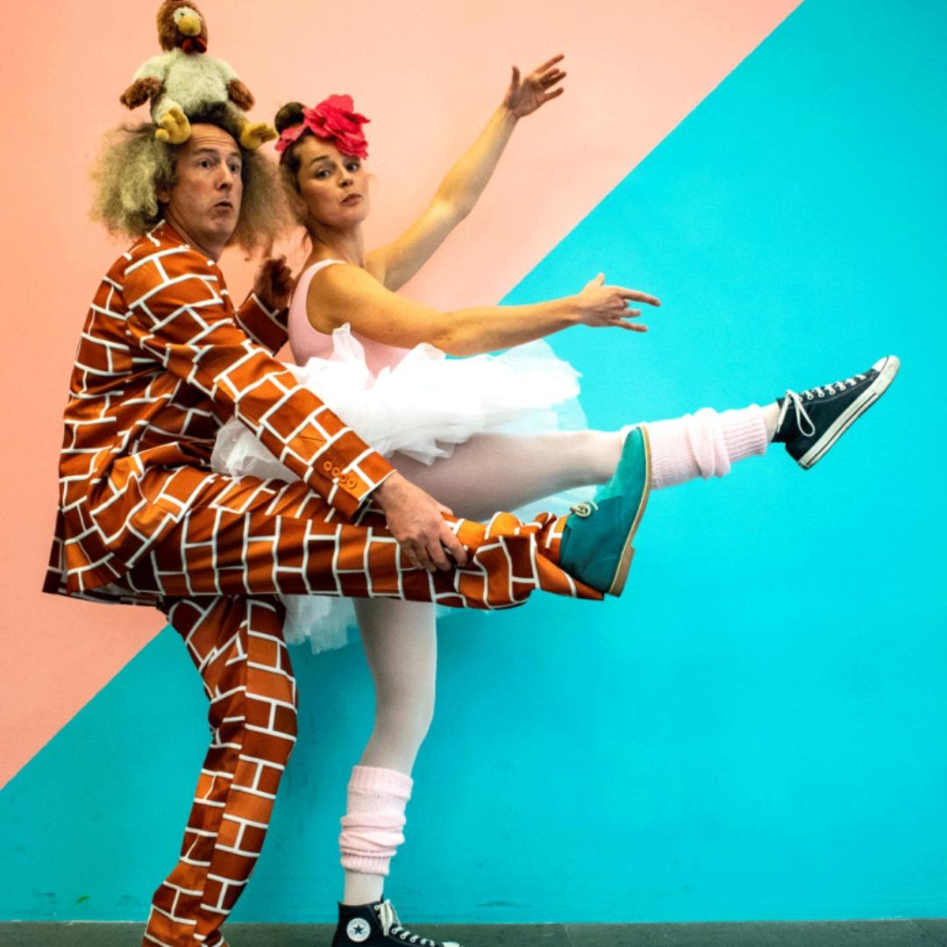

Artist Open Call
Creative Production Support Scheme 2024 & 2025

Slide 2

Welcome
Info Clinic
Artist Open Call – Creative
Production Supports 2024 & 2025
This open call is funded by Arts Council's Creative Production Supports Scheme.
With thanks and appreciation to all our partners.

Slide 3
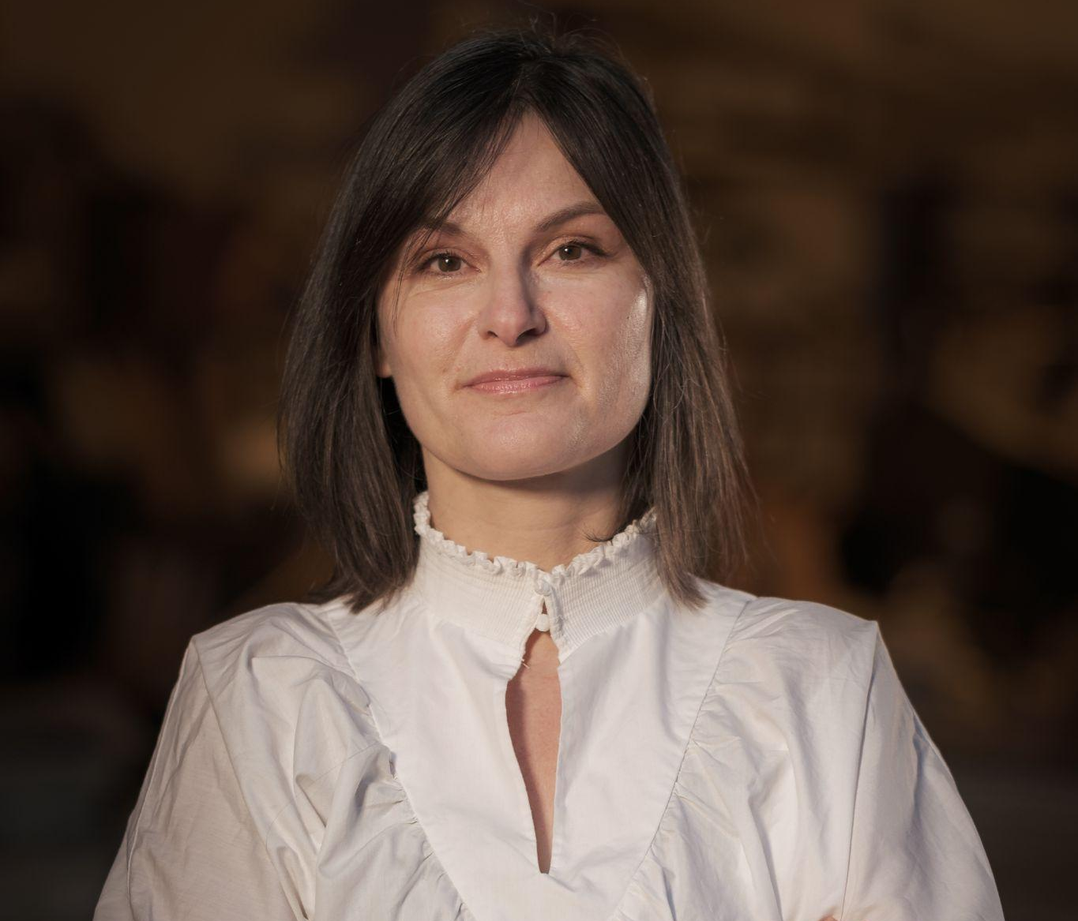
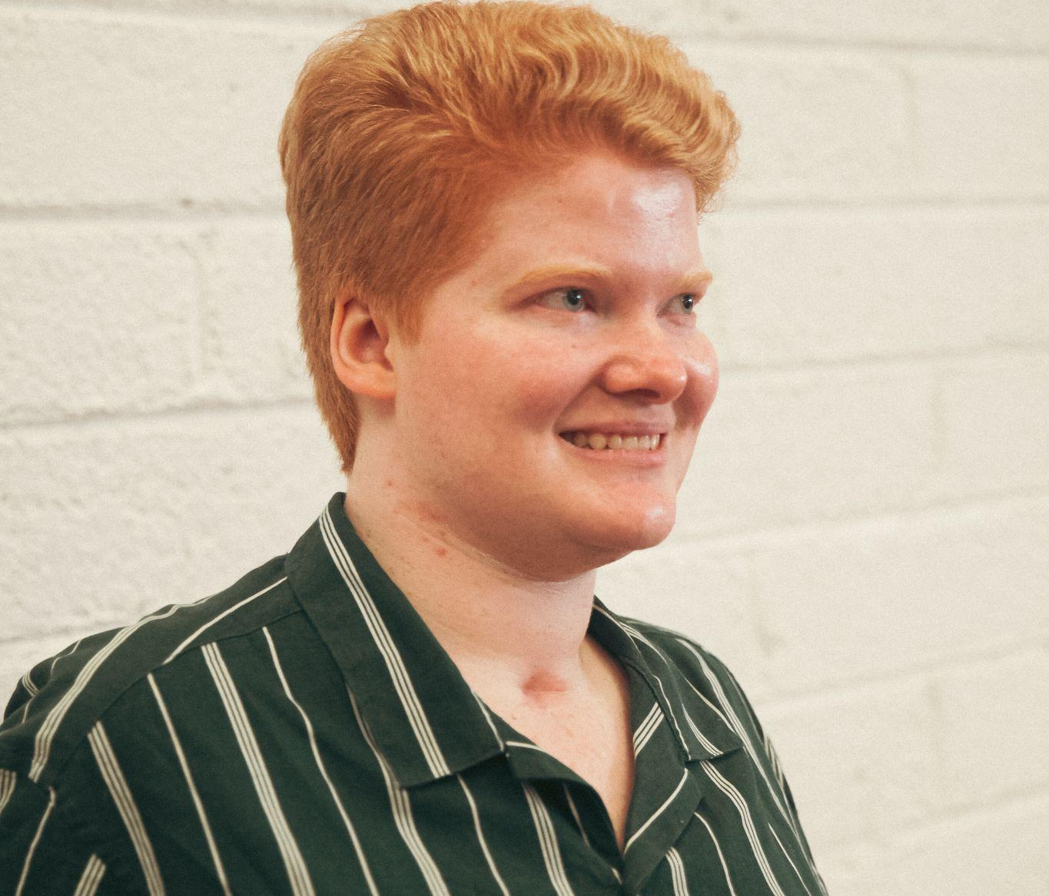
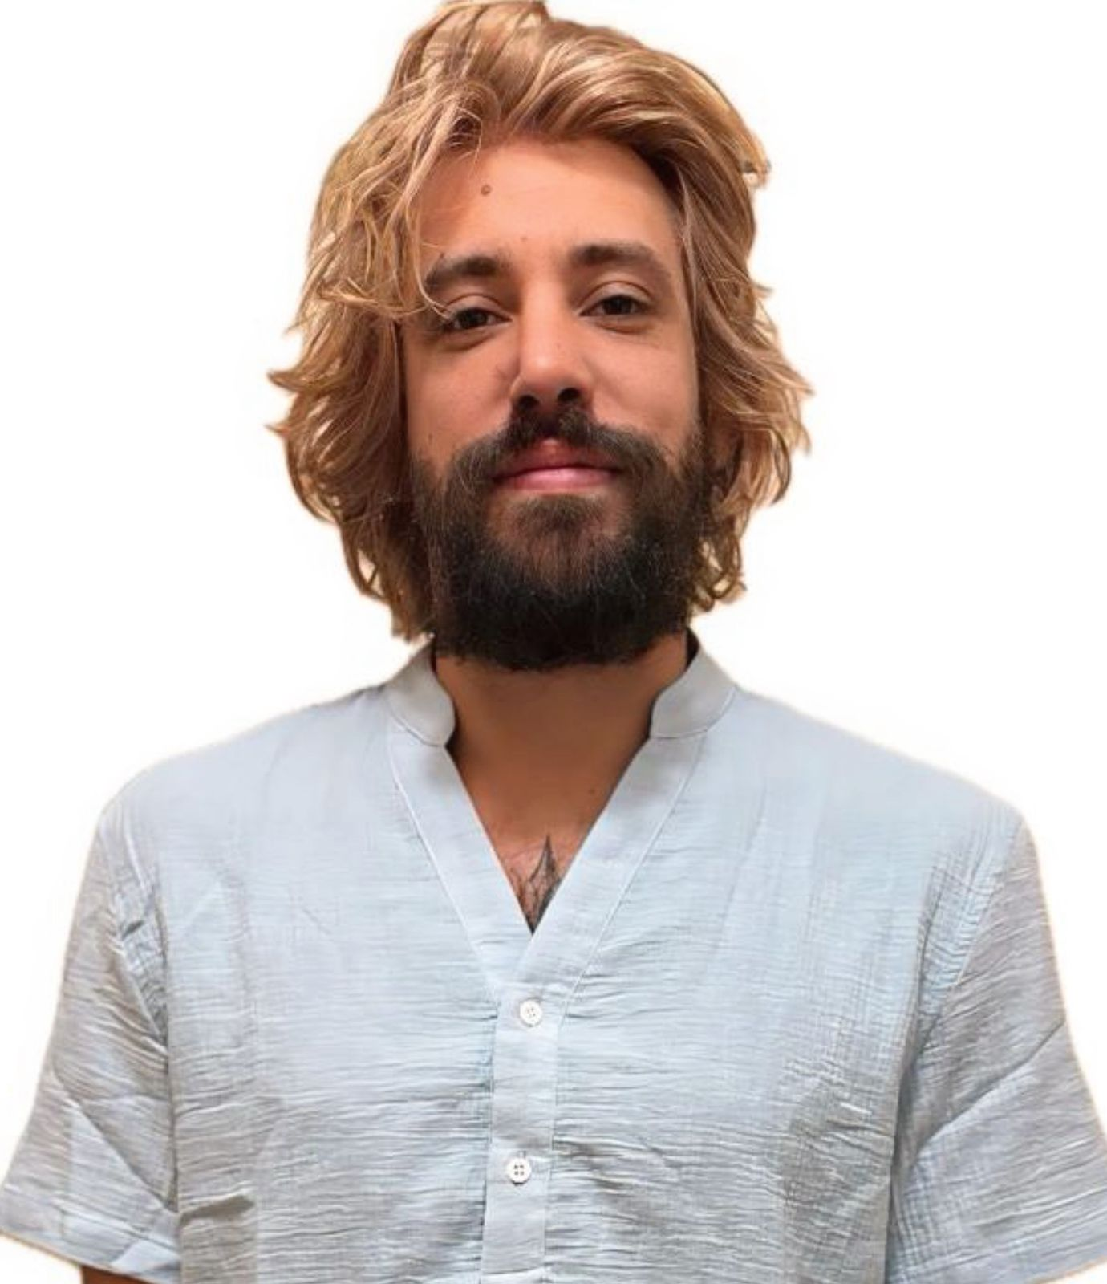
Kath Gorman, Founder/Director of Promenade An experienced creative producer, programmer and arts consultant who has worked in both Ireland and the UK across venues, festivals and resource organisations. Promenade is a recent awardee of the Arts Council’s Creative Production Supports Scheme 2024 & 2025. Past roles in Ireland include; Head of Participation & Engagement, Artistic Curator & Associate Producer for Cork Midsummer Festival and Director of Kinsale Arts Week
Ciara O'Mahony, Project Manager at Promenade Producing credits include: Cork Midsummer Festival ‘The Wind That Shakes The Wig’, Circus Factory’s ‘4 Lovers’, Pitch’d Circus & Street Arts Festival featuring a Culture Night Late event ‘Candy’s Sweet As Circus Cabaret’. Ciara sits on the board for the National Circus Festival of Ireland and is the Community Artist Curator in Residence for St. Patrick's Festival 2024 with Cork City Council.
Alexandre Maronna
is a communicator, actor, playwright, and producer. With event coordination experience, including Elton John's show production, he co-founded the Festival Playing for Change São Paulo. He also collaborated on the Container Theater and various theatrical productions. Additionally, Maronna excels in video production and collective fundraising projects.

Slide 4
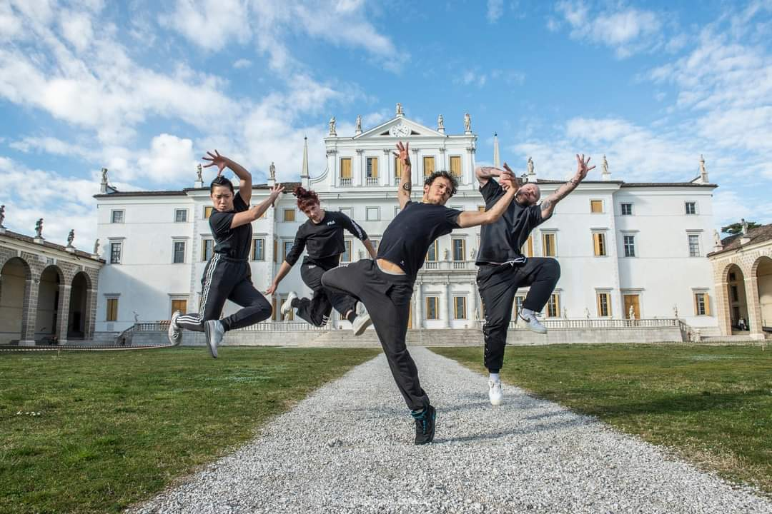
Overview
Promenade provides strategic & producing supports in the areas of circus, street arts, spectacle, public arts, participatory arts
Recently received 2 year funding from the Arts Council’s Creative Production Supports Scheme 2024 & 2025
Now seeking 5 artists / companies to apply to receive producing, production & artistic supports from the Promenade team and a range of outside experts and partners during 2024 & 2025.

Slide 5
Artist Supports
Strategic planning
Resourcing
Finance and Budgeting
4 hours per week with a Promenade Producer offering mentoring / practical support tailored to each individual artist/company needs
Circus Factory will offer one artist a one week shared residency during 2024 & 2025
The Everyman will offer three x 3 day residencies over 2024/2025.
Partnership brokering - nationally & internationally
Funding applications / bids
Project Development
Contracts & Scheduling
Public Engagement support
Work with communities / places of interest
Tour Booking
Liaising with promotors
Support with pitching / networking

Slide 6

Dramaturgical support from Georgie Brookman
Director/ artistic advisory from Aoife Carry
Production and technical advisory support by Mark Carry
Operational logistics for outdoors work by Geri Murphy
An environmental expertise group session + one to ones by Native Events
Marketing, communications & PR support from Megan Cronin and Maria Rolston

Slide 7

Selection Criteria & Priorities
Resident and primarily working in the Republic of Ireland
Artforms –
- Circus, Street Arts and Spectacle
- Outdoors Arts, Site Specific work
- Arts Participation (‘The Arts Council understands arts participation to include a broad range of practice where individuals or groups collaborate with skilled artists to make or interpret art. The practice involves a mutually beneficial two-way engagement that nurtures and values the different ideas, experiences and skills of all involved’)
- Multi-disciplinary (must include at least one of the above artforms)

Slide 8
Early-career / emerging artists
(‘An artist in the early stages of their career who is developing their practice and reputation and becoming recognised by fellow artists and critics’ definition taken from the Arts Council Making Great Art Work Glossary. )
Artists from under-represented backgrounds in the arts
(e.g. people with disabilities, from ethnic minority backgrounds, Traveller backgrounds and working-class backgrounds)
Artists who have not worked with a producer previously (may be self-producing)

Slide 9
Demonstrate potential and appetite for touring
Demonstrate interest in sustainability & the environmental footprint of your practise
Recently awarded a project award/AGF or have clear plans in progress

Slide 10

Application Process
Completed application form or a short video addressing the questions (max 5 minutes)
CV (max 2 pages)
3 examples of previous work / projects (2 pages max per example)
Email your application and supporting material to Ciara contact@promenade.ie with the subject line “ Your name / company - Artist Open Call ”
Deadline for applications: Midday - Monday 22nd April

Slide 11
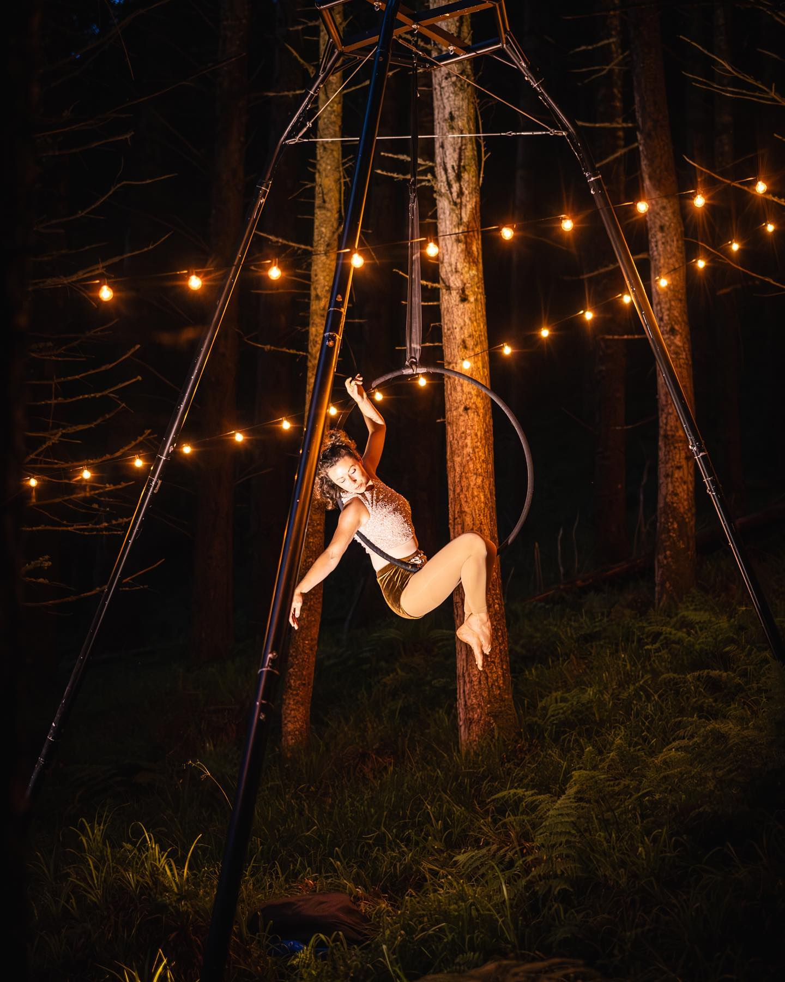
Selection Process
Shortlisted applicants from Round 1 will be notified on: Monday 29th April. Shortlisting will be against the criteria and carried out by the Promenade team.
Shortlisted applicants from Round 2 will be notified on: Monday 13th May. Shortlisting will be carried out by David Francis Moore from Dublin Fringe Festival & Michelle Carew, Arts Officer, Cork City Council plus the Promenade producing team.
Interviews for those selected will take place during the week of the 20th of May. Questions will be shared in advance.
Final decisions will be made on Friday 31st of May

Slide 12

Upcoming Events & Opportunities
Daring Dames Producers Networking Event Friday May 24th.
An opportunity to connect and meet like-minded peers.
Networking Lunch
Panel discussion on producing in a festival & rural context
Free 25-minute 1-on-1 mentoring sessions with experienced producers
5 x €150 travel/accommodation bursaries for freelance emerging producers available. Deadline Wednesday 1st of May.

Slide 13

Upcoming Events & Opportunities
Tomorrow in Cork – Networking for Creative Professionals hosted by Promenade Producer Ciara O Mahony
Part of CurrentLee Arts Festival 11am – 12 in the foyer of Cork Opera House
Join Ciara for a coffee to chat about projects, get advice and meet fellow creatives working in the arts sector.

Slide 14

Thank you & Questions
If anything occurs to you at a later stage email us:
contact@promenade.ie
Full details and link to download the application from: https://www.promenade.ie/post/artist-open-call-2024-artist-support

